Slide 1
Subject Name :Operating System Presentation Title: MAC Protocol And Wireless Network
JEPPIAAR INSTITUTE OF TECHNOLOGY
“Self-Belief | Self Discipline | Self Respect”
Department of Computer Science and Engineering
Team Members:
Students Name Reg.No:
1.Vijitta A 210618104055
2.Teena D 210618104053
3.Adhwaitha Jasmith 210618104002
4.Sharu Bency 210618104047
5.Gowshika R 210618104015
6.Sharmila Roselin P.B 210618104046

Slide 2
Objective
Today it is possible to build very small hardware devices with wireless communication for monitoring and measuring miscellaneous values of the environment. There are a lot of application areas.
Therefore a wireless solution with a battery which can be completely exchanged periodically is more eligible, but only if the exchange period is not too small. An other utilization for wireless sensors is medical observation
>The medical devices have to exchange information about their health status. A small wireless sensor can realize this task. It could send an emergency signal in case and with a long battery lifetime it needs less servicing. That seems more useful than a large or even wired device

Slide 3
Technical Details
A Wireless Medium is a shared medium. This means one instance in the signal range is allowed to send data at most.
This data can be received by one or more attendees.
The MAC Protocol has to transmit given information frames over this shared medium to a network peer.
To do so it is required that every network peer has an identifier. This is usually called a MAC address and has to be unique for the current network.
It is even better if the address is global unique because adding or exchanging sensors in different networks might be possible.

Slide 4
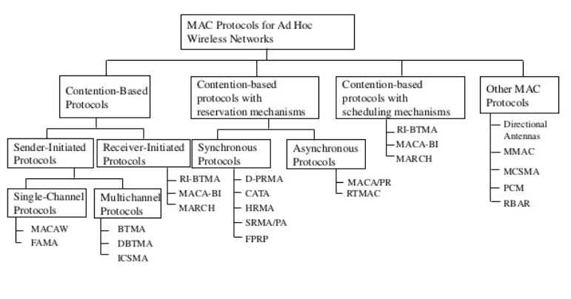
Block Diagram/ Work Flow/ Flow Chart

Slide 5
Technical Details
B-MAC is designed for an Ad-Hoc network of nodes with N-sender to 1-receiver transmissions.
The basic idea of B-MAC is to keep the protocol simple. That allows very small implementations, an important point because of the limited available memory.
Like the other protocols B-MAC uses periodically sleep/wakeup cycles. The mechanism used here is called Low Power Listening.
LPL means in the wakeup time the node listens for incoming data transmissions. If there is no data received, called a “false positive”, a timeout interrupts the listen state.

Slide 6
Technical Details
X-MAC protocol
one of typical asynchronous MAC protocols for WSNs (Wireless Sensor Networks) allowing each node to independently and periodically sleep, is characterized as sending a sequence of short preambles until an early acknowledgement comes back

Slide 7
Technical Details
X-MAC and B-MAC X-MAC is based on the idea of B-MAC.
.There is no direct comparison between X-MAC and B-MAC, but an LPL protocol similar to X-MAC may be comparable to B-MAC.
To demonstrate the advantage of the strobed announcements Buettner, Yee, Anderson and Han set up a network where each node can reach all 8 others. There are messages send to one destination periodically.
This is expected from the optimized preamble communication. Nodes which are not affected in the current transmission can quickly go back to sleep.
By the direct transmission of a third waiting node to the the target after a finished transmission without a preamble procedure time is reduced.

Slide 8
Technical Details
WiseMAC and X-MAC
WiseMAC is based on the concept of IEEE802.15.4 with infrastructure topology.
Because of the central communication control by the access point overhearing is minimized
. Also there is no message forwarding by the nodes. That increases the lifetime of the nodes.
The time spend waiting for ready peers is minimized too, because the central peer is able to listen always when it is idle.
I assume WiseMAC using Acknowledgements for data transmission increase latency significantly as shown for other protocols.

Slide 9
Technical Details
Wireless sensor networks.
Distributed turbine engine control
Fly-by-wireless; Aircraft enginehealth monitoring, Aircraft structural monitoring
applications of wireless communications in daily life because of low cost and ease of deployment.
The enabling technique for this success is the use of random access schemes for the wireless channel.

Slide 10
Result & Discussion
At my opinion there are many good ideas for intelligent energy reduction. But there is still optimization possible.
Not only Wireless radios don't need to stay active all of the time, sensors are measuring for a short time and than they can sleep too.
In these situation the whole device is idle and could go to sleep. To do so there could control mechanism accessible by the Mac protocol because typically the network is more frequently used than the sensor itself.
A global control only by the operating system might cause overhead and delay

Slide 11
Future Scope
>Adaptive hierarchical MAC protocol (AH-MAC) with cross-layer optimization for low-rate and large-scale wireless sensor networks. The main goal of the proposed protocol is to combine the strengths of LEACH and IEEE 802.15.
Wireless sensor networks (WSN)
Designed for data gathering and processing,
with particular requirements: low hardware complexity,
low energy consumption, special trafﬁc pattern support,
scalability, and in some cases, real-time operation

Slide 12
Reference
.
.
W. Ye, J. Heidemann and D. Estrin, “Medium Access Control With Coordinated Adaptive Sleeping for Wireless Sensor Networks” IEEE/ACM Transactions on Networking
A. El-Hoiydi and J.-D. Decotingie, “WiseMAC: An Ultra Low Power MAC Protocol for the Downlink of Infrastructure Wireless Sensor Networks“, CSEM, Swiss Center of Electronics and Microtechnology, Inc., 2007
J. Polastre, J. Hill and D. Culler, “Versatile Low Power Media Access for Wireless Sensor Networks”, SenSys'04, ACM 1-58113-879-2/04/0011, November 3-5, 2004

